Slide 1
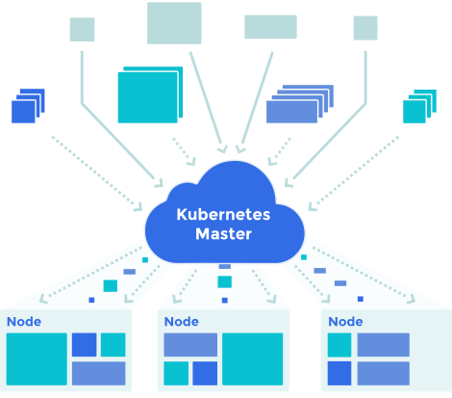
Custom Kubernetes Scheduler
Image from: Google. Kubernetes scheduler. url: http://kubernetes.io.

Slide 2
We’ll be covering..
Kubernetes Overview + Project Goal
Building the Custom Scheduler
Results
Conclusion
Notes:
Kubernetes Overview + Project Goal →
Building the Custom Scheduler →
Testing → simulating the testing environment to study scheduler behavior
Results → comparison between default and custom scheduler
Conclusion → challenges faced, next steps

Slide 3
Kubernetes Overview + Project Goal

Slide 4
Kubernetes Terminology
Kubernetes → Manages containerized applications.
Containers → Docker images of applications.
Pod → contains 1 or more containers
Node → a worker machine (VM / physical machine)
kubelet
kube-proxy
container runtime (e.g. Docker)
Cluster → 1 or more nodes + Master
Master → the cluster’s control plane
Makes global decisions
Includes important components like kube-apiserver (that exposes the Kubernetes API), controller manager, etcd and kube-scheduler.
Notes:
You create your Docker image and push it to a registry before referring to it in a Kubernetes pod.
Each node contains services necessary to run pods:
kubelet is an agent that runs on each node, that makes sure that containers are running in a pod. The kubelet takes a set of PodSpecs and ensures that the containers described in those PodSpecs are running and healthy.
The container runtime is the software that is responsible for running containers. E.g. Docker, containerd
kube-proxy is a network proxy responsible for request forwarding. kube-proxy allows TCP and UDP stream forwarding or round robin TCP and UDP forwarding across a set of backend functions.

Slide 5
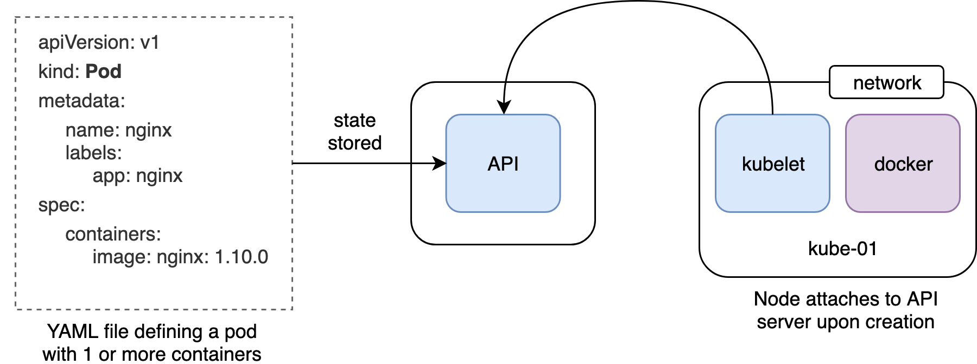
K8s Declarative Model
Notes:
When a pod is created, it does not actually start running. It simply stores the state in the K8s API server.
e.g. run a container called nginx using this particular container image.
When a node is created it attaches to the API server.

Slide 6
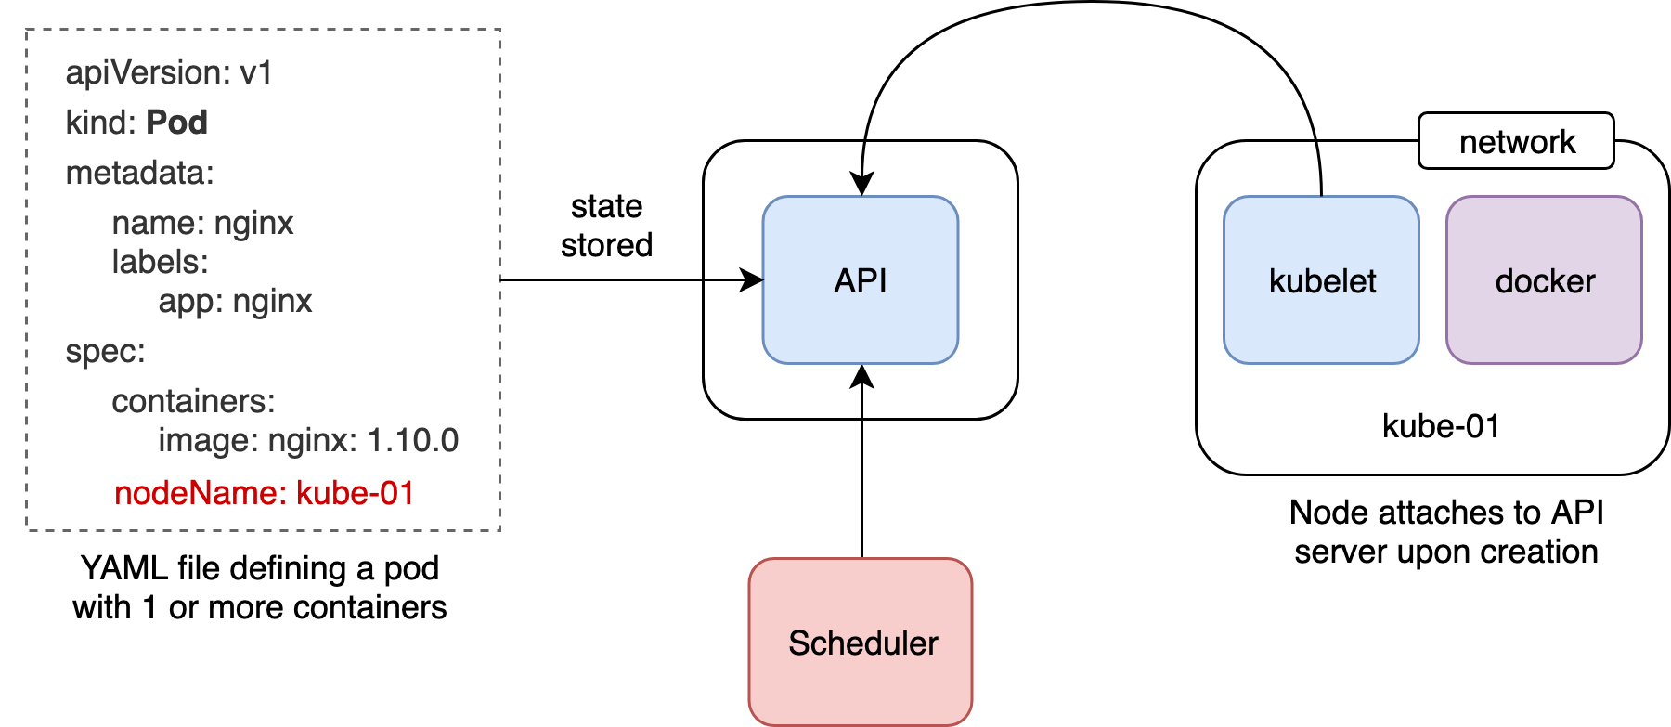
K8s Declarative Model
Notes:
The scheduler assigns/binds a pod to a compatible node. kubelet runs all the containers in the pods assigned to the specific node.

Slide 7
Default Scheduler
Predicates (hard constraints)
System or user supplied, e.g. memory/CPU requests
Applied first to filter out nodes that don’t have enough available resources
Priorities (soft constraints)
Used to rank nodes that weren’t filtered out by the predicate check
Tries to spread pods across zones and nodes
Favors least-loaded nodes
Load = Total resource requests (cpu/memory) for all pods / Node capacity
Notes:
Spreading: desire for an app to be across machines, so that if one machine fails, the entire app does not fail.
Least loaded nodes are the determined based on the memory requested by the pod that run on the node. The actual memory usage(which can be higher or lower than requested) isn’t considered.

Slide 8
Our Custom Scheduler Objective
Optimize memory utilization by finding the node with the most memory available
Metric Used : Node_Memory_memAvailable.
The pod is scheduled on the node with most memory available.
Ensures proper memory usage across the nodes by avoiding memory intensive pods on the same node.
Notes:
Unlike the default scheduler which favors the least loaded node the custom scheduler aims to spread the memory usage across the nodes and avoids scheduling memory intensive applications/pods on the same node.

Slide 9
Building the Custom Scheduler

Slide 10
Methodology
Scheduler needs to do the following:
Find unscheduled pods
For each unscheduled pod:
Select ‘best’ node
Bind pod with selected node
Selecting the ‘Best’ node:
Find all nodes compatible with pod, i.e. satisfy requested CPU & memory.
Retrieve the relevant metric data (available memory) for each compatible node.
Select the node with the max metric value.

Slide 11
Tech Stack
Kubernetes + Docker
Kubeadm-dind-cluster (KDC) → to create a multi-node K8s cluster locally
Based on kubeadm and DIND (Docker in Docker)
YAML files → to define K8s pods and deployments
Prometheus Node Exporter → to scrape node metrics
GoLang → custom scheduler development
PromQL + Prometheus HTTP API → querying metric data

Slide 12
Implementation
Guided by:
Kelsey Hightower’s demo - Building a custom Kubernetes scheduler (GopherCon, 2016) Url: https://www.youtube.com/watch?v=IYcL0Un1io0
A toy scheduler that uses manually-added node annotations to make scheduling decisions.
Parts of it formed the base for our scheduler:
monitoring and getting unscheduled pods
running the initial predicate checks
binding pods

Slide 13
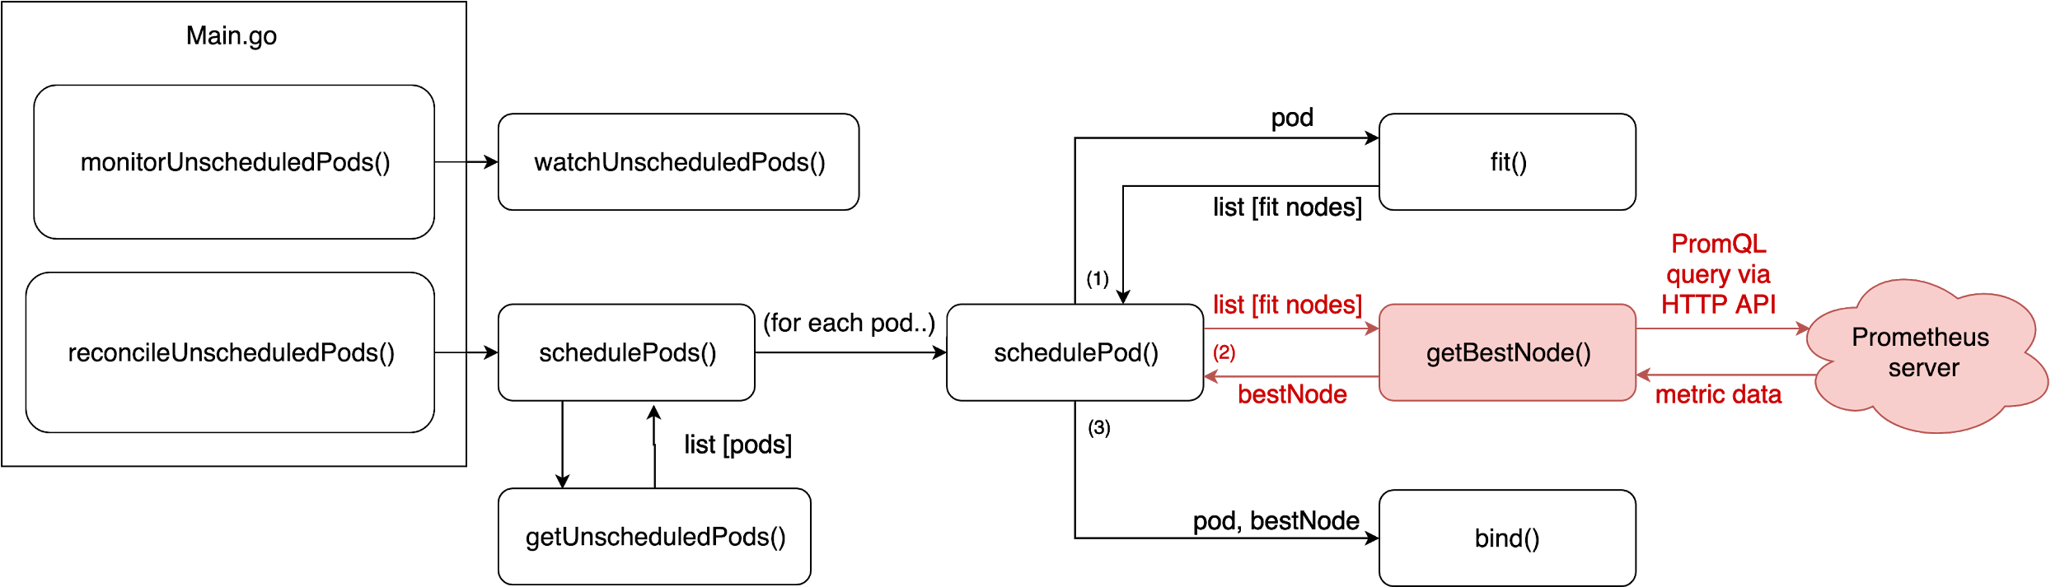
Implementation

Slide 14
Implementation
http.Get("http://localhost:8080/api/v1/query?query=node_memory_MemAvailable")

Slide 15
Results

Slide 16
Test Setup: Custom vs Default Scheduler
One pod using much more memory than requested, and the other pods using much less memory than requested
Sleep pods running on two nodes
Request memory (70% of capacity) so that the nodes will seem loaded
Sysbench pod running on the third node
Runs a long memory test to significantly reduce the memory available on the node, without requesting memory

Slide 17
Test Setup: Custom vs Default Scheduler
Expect default scheduler to schedule pod on node with least memory requests
Node running sysbench
Expect custom scheduler to schedule pod on node with most available memory
Node running sleep

Slide 18
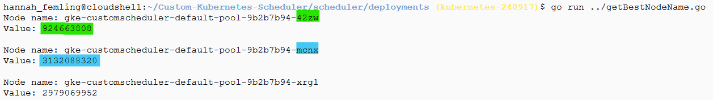
Test Setup: Custom vs Default Scheduler
Memory available before scheduling a new pod:

Slide 19
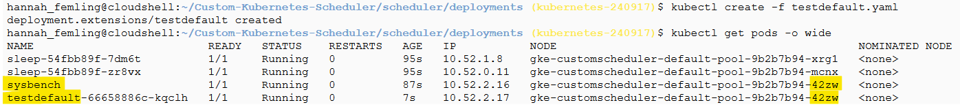
Scheduling a pod with the Default Scheduler
The new pod was scheduled on the node running sysbench (least memory requested)

Slide 20
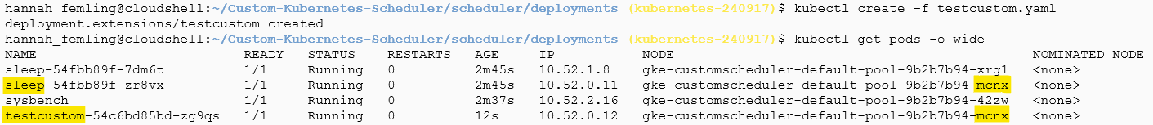
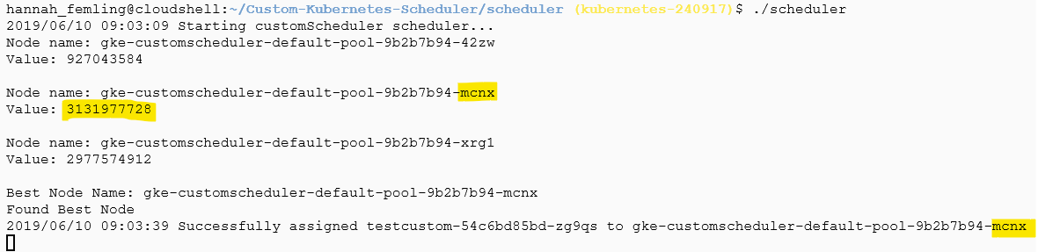
Scheduling a pod with the Custom Scheduler

Slide 21
Conclusion

Slide 22
Potential improvements
Extend scheduler to track memory utilization over time, instead of just at the time a pod is scheduled
Extend scheduler to apply priority functions. (e.g. prioritize spreading replicas of same app across different nodes)
Explore alternate monitoring tools (e.g. Weavescope, Jaeger) and study the comparison between them
Use more than one metrics to determine the best node
Notes:
Our scheduler does not currently apply the priority functions that the default scheduler does. For instance, it will not try to prioritize spreading replicas of the same app across different nodes. This is something that be added in the future.

Slide 23
Challenges faced
Installation issues - incompatibility with OS type and version
Creation of multi-node clusters on local machines
KDC tool - Mac
Kubernetes engine on the google cloud console - windows
Finding a way scrape and retrieve node metric
Test setup to compare default and custom schedulers

Slide 24
References
Questions?
GopherCon 2016: Kelsey Hightower - Building a custom Kubernetes scheduler. Url: https://www.youtube.com/watch?v=IYcL0Un1io0
Hightower Toy Scheduler. Url: https://github.com/kelseyhightower/scheduler
Kubernetes concepts https://kubernetes.io/docs/concepts/
A Deep Dive into Kubernetes Metrics
https://blog.freshtracks.io/a-deep-dive-into-kubernetes-metrics-part-2-c869581e9f29
Sysbench workload
https://wiki.gentoo.org/wiki/Sysbench#Using_the_memory_workload
Kubernetes Scheduler. Url: https://github.com/kubernetes/community/blob/master/contributors/devel/sig-scheduling/scheduler.md
Prometheus. Url: https://prometheus.io/
Node Exporter. Url: https://prometheus.io/docs/guides/node-exporter/

